Slide 1



Advanced Algorithms for Terahertz Sensing and Recognition
Murat Torlak and Yiorgos Makris
University of Texas at Dallas
Texas Instruments Foundational Technology Research Program on Millimeter Wave and High Frequency Microsystems
University of Texas at Dallas
June 12, 2020

Slide 2
Advanced Algorithms for THz Sensing and Recognition
Description: Understand the limitations and challenges in THz FPA/IR imaging technology; identify solutions for target applications such as 3D gesture recognition, movement and presence detection.
Goals: Develop advanced real-time multi-antenna signal processing techniques for THz FPA/IR sensors to reconstruct and recognize targets in complex environments.
Principal Investigators: Murat Torlak (University of Texas at Dallas)
Yiorgos Makris (University of Texas at Dallas)
Students Current Status
Josiah W. Smith (MT) PhD (Fall’19)
Shiva Shankar Thiagarajan (YM) PhD (Sp’18)
Bhaskar Raj Upadhyay (MT) PhD (Fall’18)
Richard Willis, (YM) Intern
TI Liaisons:
Aleksandar Purkovic, Arthur Redfern, Anand Dabak, Dan Wang

Slide 3
Plans and Deliverables (Year 2/3)
Milestones
Developed a MATLAB based GUI to streamline raw mmWave radar and IR sensor data collection
Performed the initial testing of machine learning methods with real mmWave data sets
Two PhD students (Josiah/Bhaskar) working on various application such as gesture recognition/imaging with 77GHz TI radar until THz radar becomes available
Students (Richard/Shiva) working on advances machine learning algorithms for dynamic gestures (static gestures before), implemented a flexible python-based infrastructure for gesture recognition using radar information.
Trained models were investigated for various shortcomings and refined to improve the model robustness.
Deliverables
Software on the HGR DSP and ML methods (Nov. 15, 2020)
THz imaging testbed (Nov. 15, 2020)

Slide 4
Revised Schedule after TI Feedback
Year | 1 | 2 | 3 | 4 | 5
Milestones | Develop a detailed mathematical model for THz FPA with reflectors and THz transceivers. Develop a geometric reference model including Doppler shift patterns for 3D gesture recognition and motion detection Software implementation of machine learning algorithms for THz sensing/imaging. | Complete 24/77 GHz hardware demonstrator with existing chipsets to achieve millimeter-scale accuracy in 3D gesture recognition and motion recognition. Develop multi antenna signal processing to reduce speckles and to correct reflector aberration and machine learning techniques. | Software implementation of real-time multi antenna signal processing techniques and machine learning algorithms for THz-FPA on a custom CPU+GPU. Refine the mathematical models of THz-FPA and geometric models based on 77 GHz demonstrator results. | Verify and fine tune low complexity algorithms with THz FPA on silicon with TI and center collaborators. Software implementation of machine learning algorithms on a custom CPU+GPU for THz sensors. Finalize the algorithms to eliminate errors due to multipath. | (If all the milestones are met and authorized by TI) Build and characterize optimized resolution limits of THz FPA with THz chipsets incorporating reflectors and machine learning on CPU/GPU/FPGA for 3D gesture and motion recognition. Characterize the performance limits of aberration mitigation algorithms.
Deliverables | Report on the mathematical model of THz FPA with reflectors and THz radios Report on geometric models for 3D gesture recognition and the machine learning algorithms for THz sensing/imaging | Report on measurement results using 24/77 GHz demonstrator. Software implementation of multi antenna signal processing and machine learning for THz-FPA gesture and motion detection | Report on software implementation and refined mathematical models of the end-to-end sensing and imaging system with machine learning algorithms. Report on the algorithms to increase field of view. | Report on measurement results on the performance limits of multiantenna signal processing algorithms and machine learning techniques used in THz-FPA sensors. | Report on measurement results of fully functional THz-FPA imager enabled by real-time multiantenna signal processing algorithms and machine learning. CPU/GPU/FPGA software.

Slide 5
TI Feedback
Well-attended monthly conference calls. Continuous engagement with TI engineers.
Preprocessing versus ML complexity for more efficient and lower error rate classification
Response: Some pre-processing methods are very useful. Angle/Range FFT. More details will be given in the presentation.
How to quantify the preprocessing versus ML trade off.
Response: Empirical complexity and accuracy analysis has been done for gesture recognition. More details in the presentation.
Hardware/software interaction
Response: All of our processing is offline. We have been using our own MATLAB based GUI while mmWave radar studio is running in the background. For real-time operation, we have to port the algorithms into built-in DSP.
Pick an end application to target the system.
Response: Gesture recognition has many elements to demonstrate the system performance. We are also looking at (narrowband) imaging as well.

Slide 6


Front-End Signal Processing and Applications
Josiah W. Smith and Murat Torlak

Slide 7
Outline
Static Pattern Recognition
Static Gesture Recognition
Sterile Gesture Training
Dynamic Pattern Recognition
Dynamic Gesture Recognition
Medication Packaging Insert Detection
Conclusion
Future Work
THz IC

Slide 8
Static Gesture Recognition

Slide 9
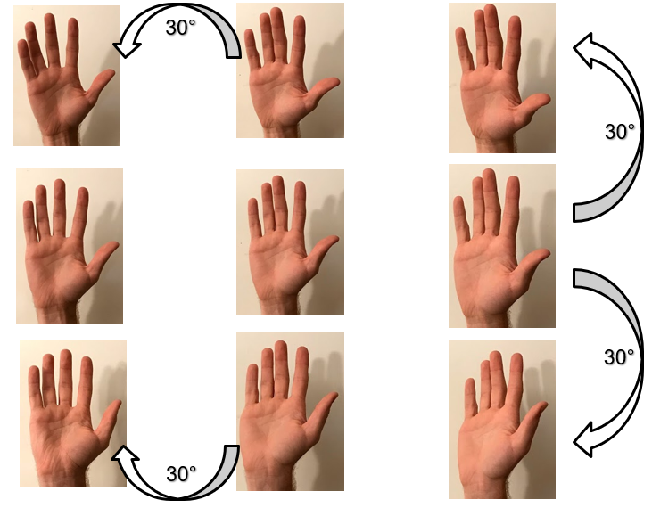
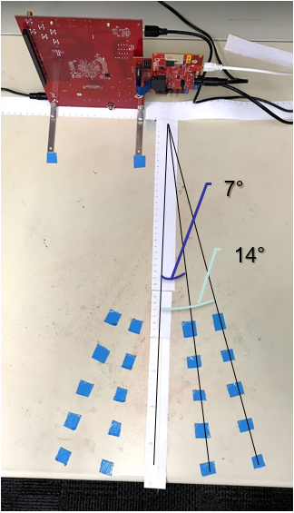
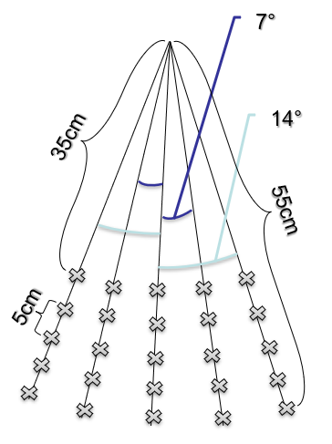
Old Setup
Move hand to multiple locations
Time-consuming process
75% classification accuracy

Slide 10
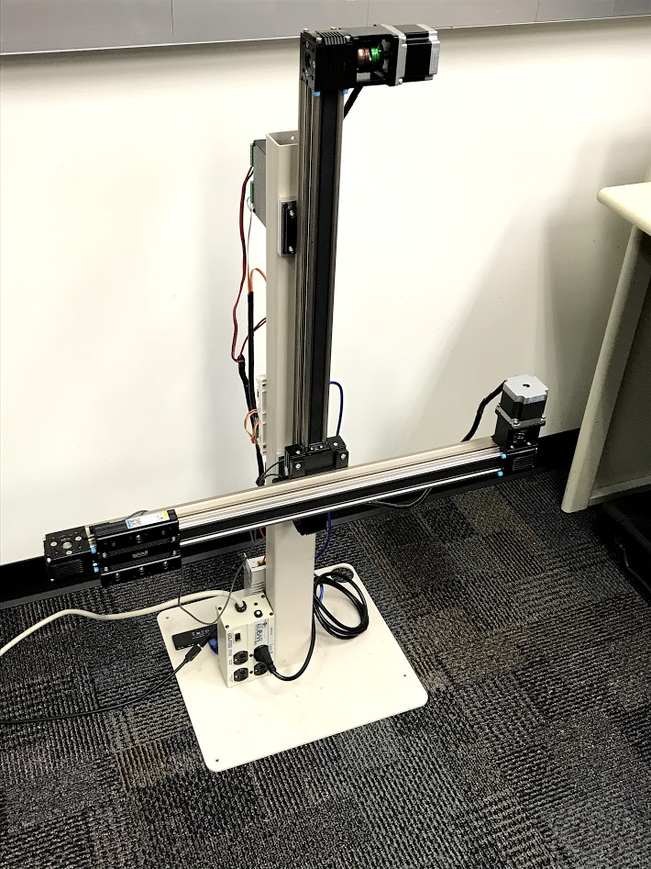
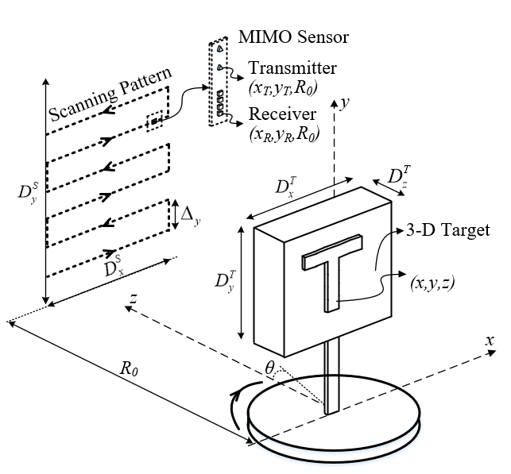
New Static Data Collection – Scanner
Move radar along planar aperture
Quickly obtain many perspectives of gesture!

Slide 11
Sterile Gesture Training

Slide 12
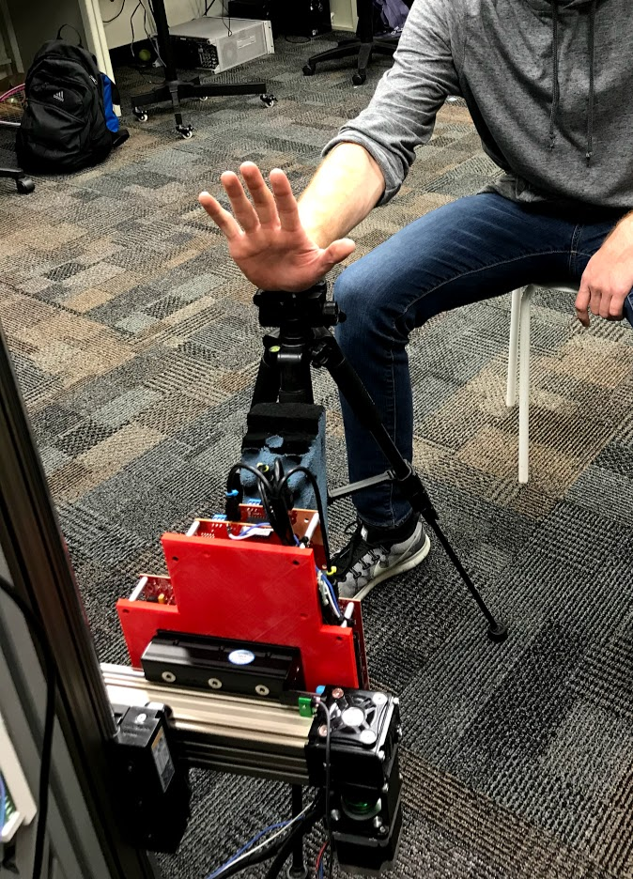
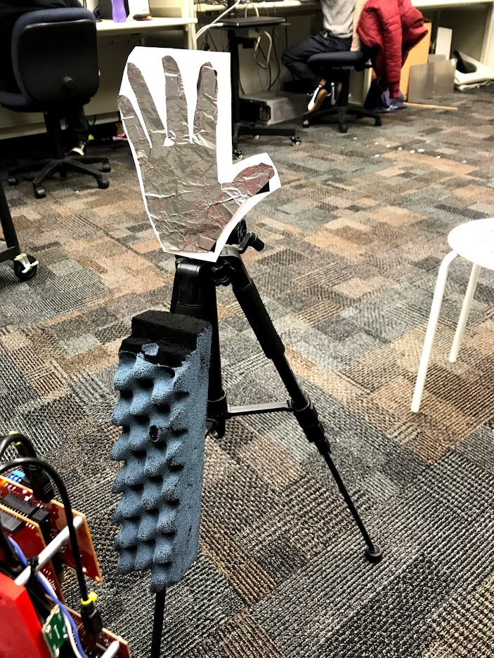
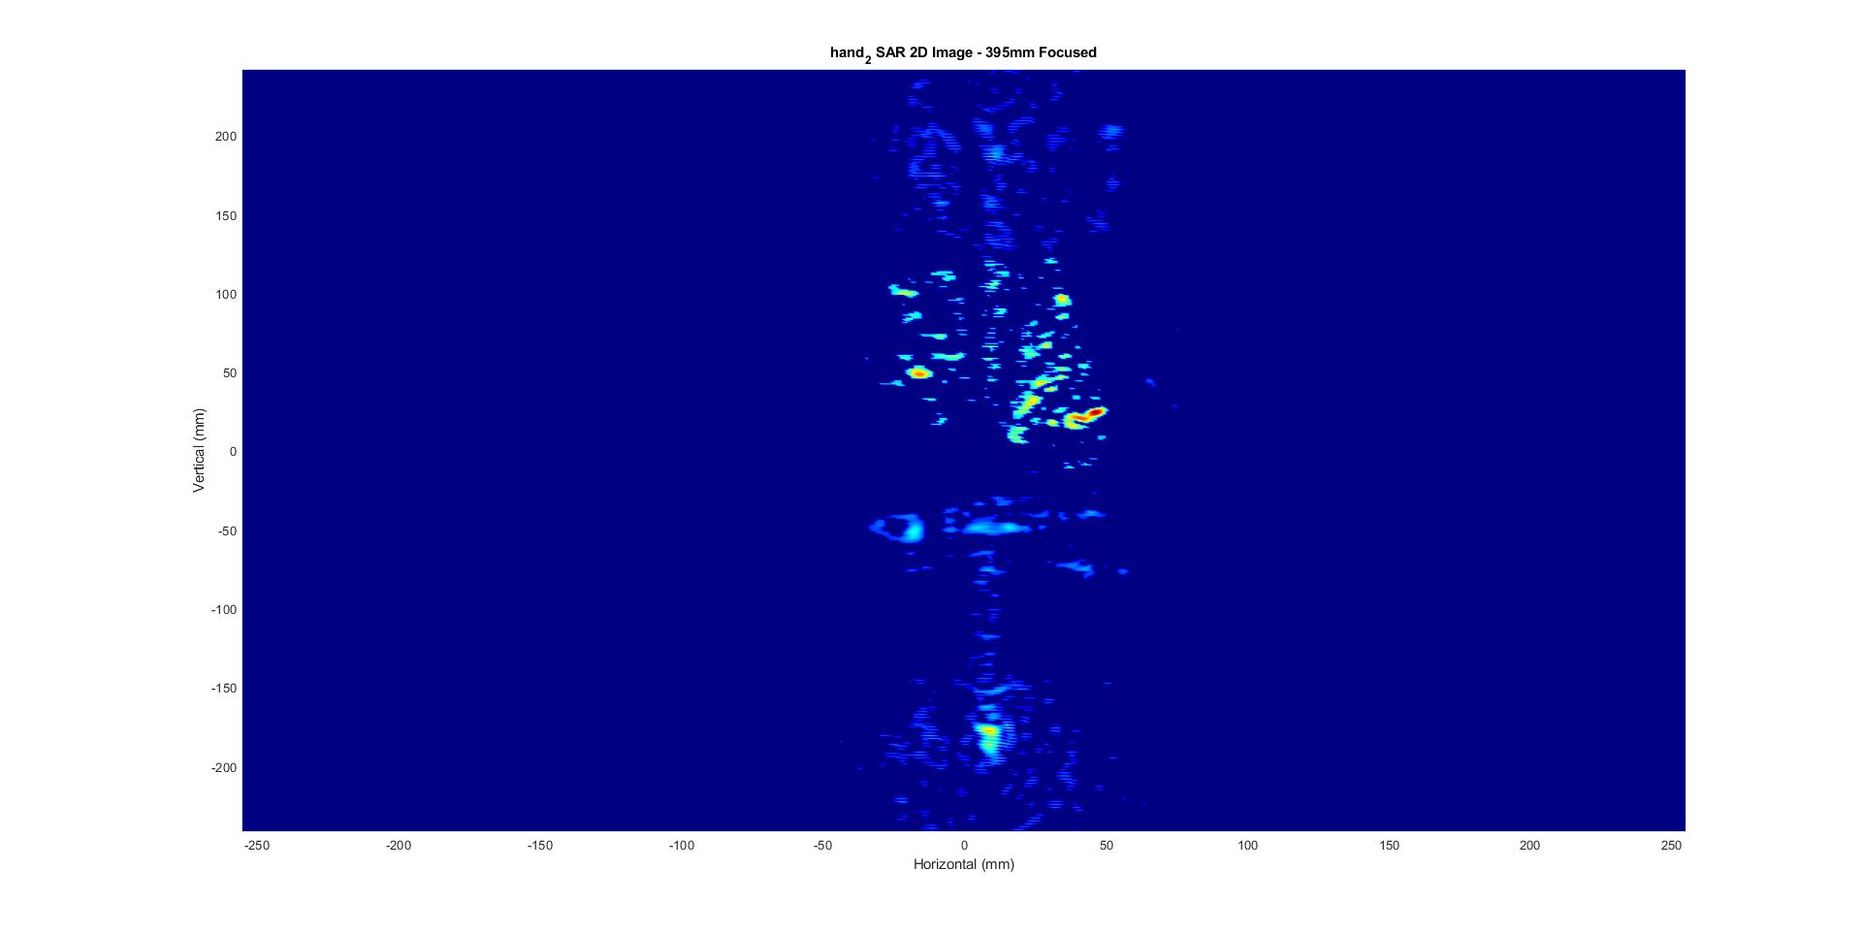
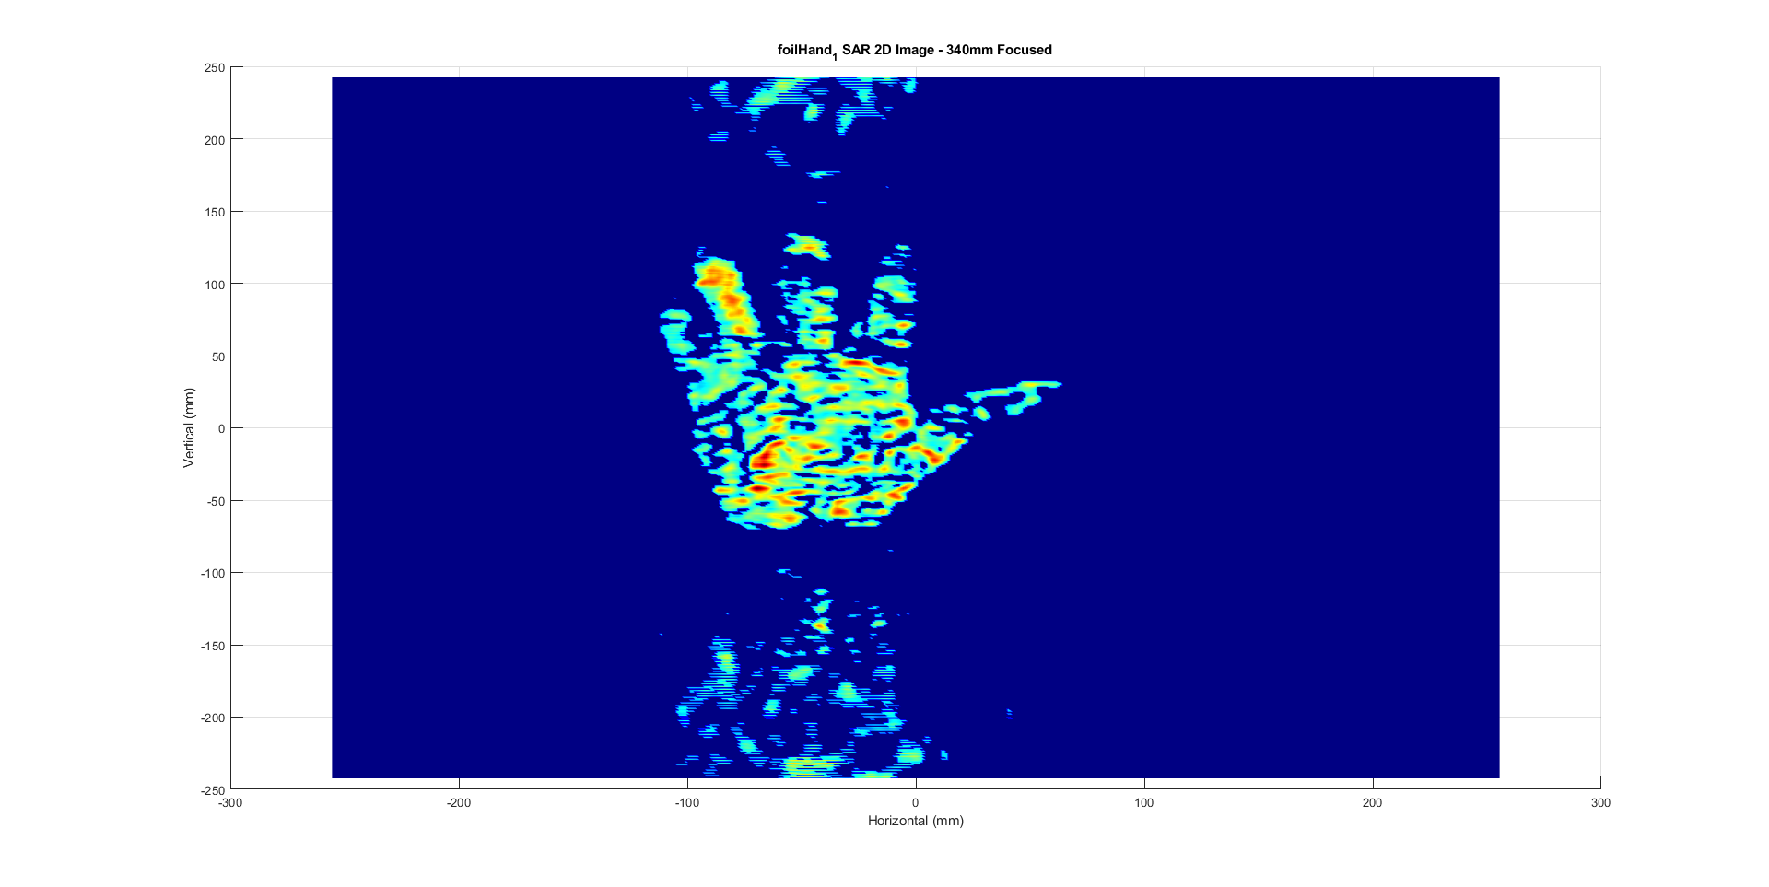
Sterile Dataset
Human Hand– 40000/class
3 gesture classes
Foil Cutout– 40000/class
3 corresponding foil “cutout” classes
Size per class: (64, 8, 40000)
64: range FFT bins
8: virtual antennas
40000: hand in different positions
Foil cutout has much higher RCS

Slide 13
Sterile Gesture Training: Results
Scenarios:
Train with human data, test with human data
Train with 40% human data 60% cutout “sterile” data, test with human data
Range FFT Range Angle FFT
Results: 85% 90%
Results: 93% 95%
Conclusion: “sterile” data improves classification accuracy

Slide 14
Sterile Gesture Training: Range FFT
Human Data Only: 85%
Human + Sterile Data: 93%

Slide 15
Sterile Gesture Training: Range Angle FFT
Human Data Only: 90%
Human + Sterile Data: 95%

Slide 16
Dynamic Gesture Recognition

Slide 17
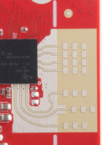
Dynamic Datasets
Dataset 5 – 600/class
Horizontal antenna array
Captured across different days, same subject
Dataset 6 – 1200/class
Vertical antenna array
Captured across different days, different subjects
Size of data for each class (64, 8, 64, C)
64: range FFT bins
8: virtual antennas
64: slow-time (frame index)
C: captures/class
Horizontal Array
Vertical Array

Slide 18
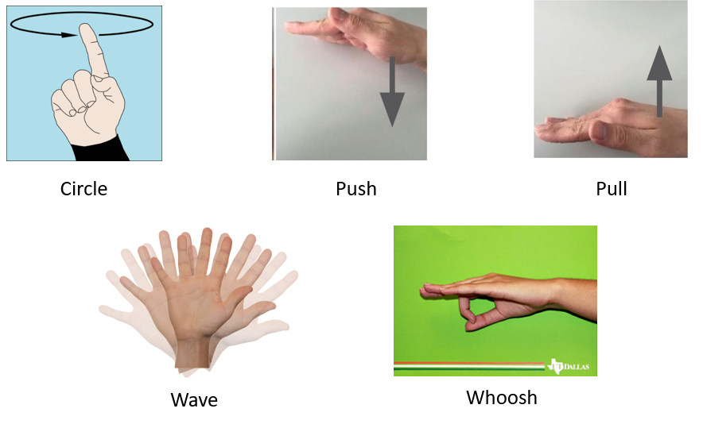
Results
Preprocessing:
Range FFT -> use only hand and torso bins
Doppler FFT
Use only one sensor
Dataset 5 – Horizontal
100% classification accuracy
Dataset 6 – Vertical
98% classification accuracy
Combined – Horizontal and Vertical Data
70% classification accuracy – can we improve??
Size of data for each class (25, 64, C)
25: range bins
64: doppler bins (velocity)
C: captures/class

Slide 19
Computational Efficiency Analysis
Range Doppler
Range FFT
Range, Angle, Doppler, 40ms
Range FFT 40ms
BEST!
Range Doppler 1 Channel
Range Doppler Filtered 1 Channel
Range FFT 1 Channel 40ms

Slide 20
Medication Packaging Insert Detection

Slide 21
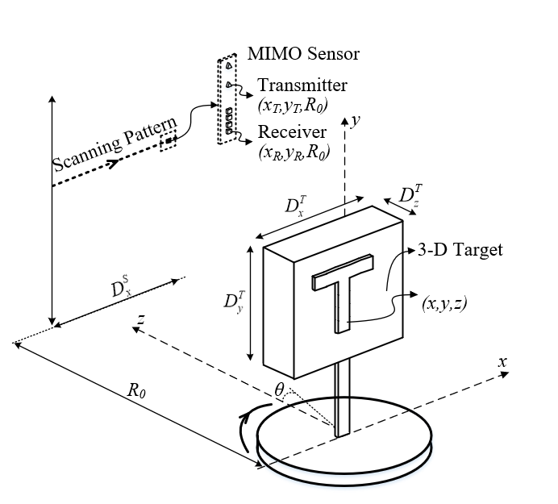
Medication Packaging Insert Detection
Problem Setup:
Box with bottle mounted on rotator
Radar scanned horizontally at constant speed
Discrete captures every 0.5mm
After each horizontal scan, rotation by 3.6°

Slide 22
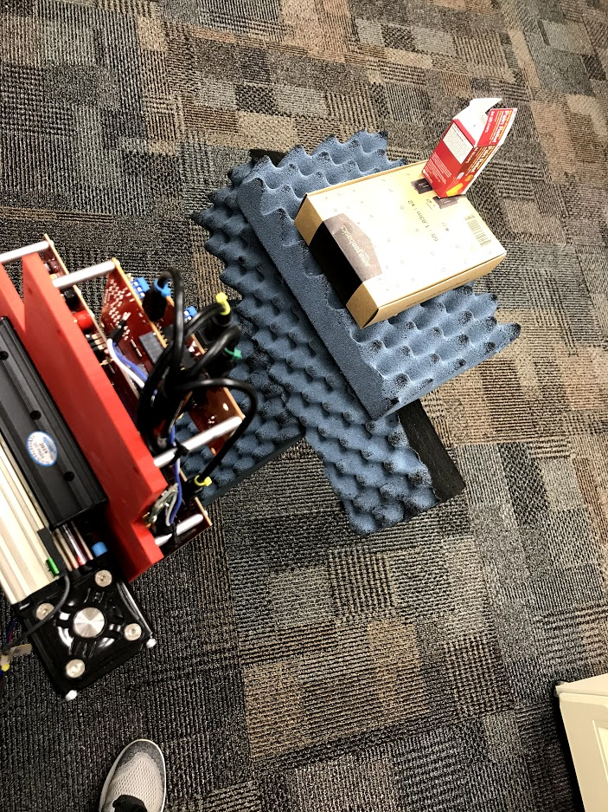
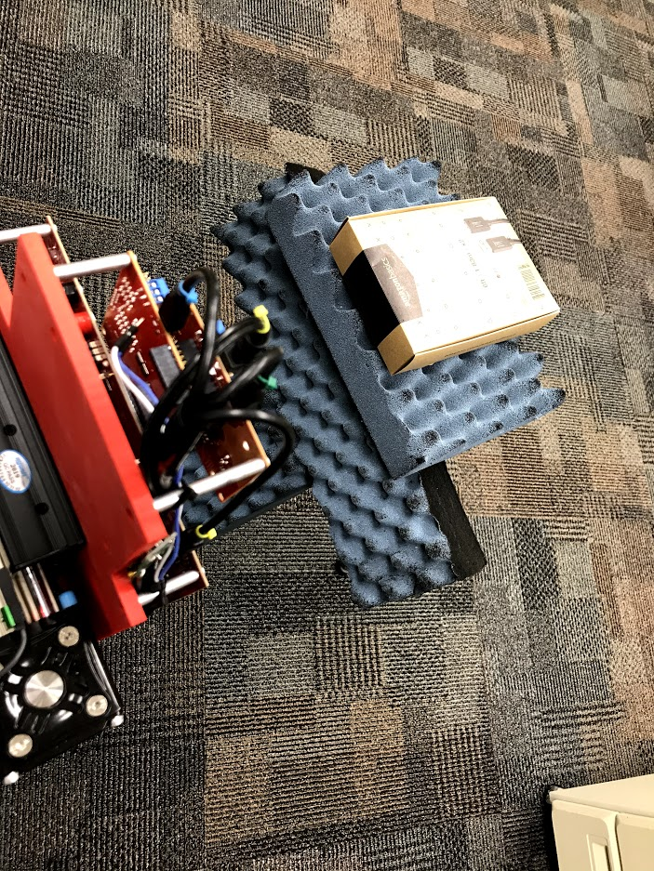
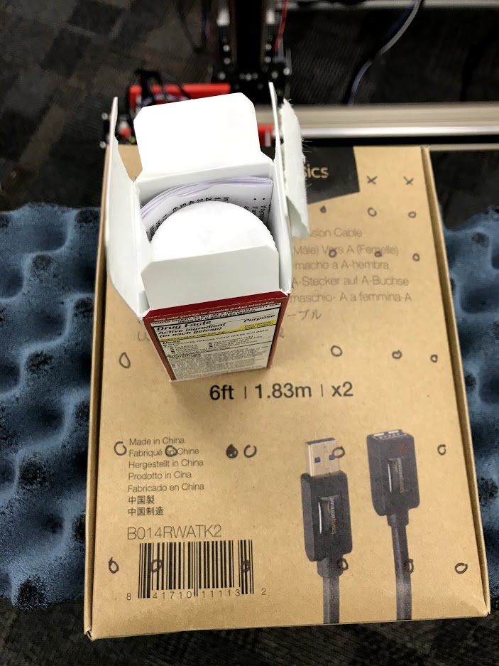
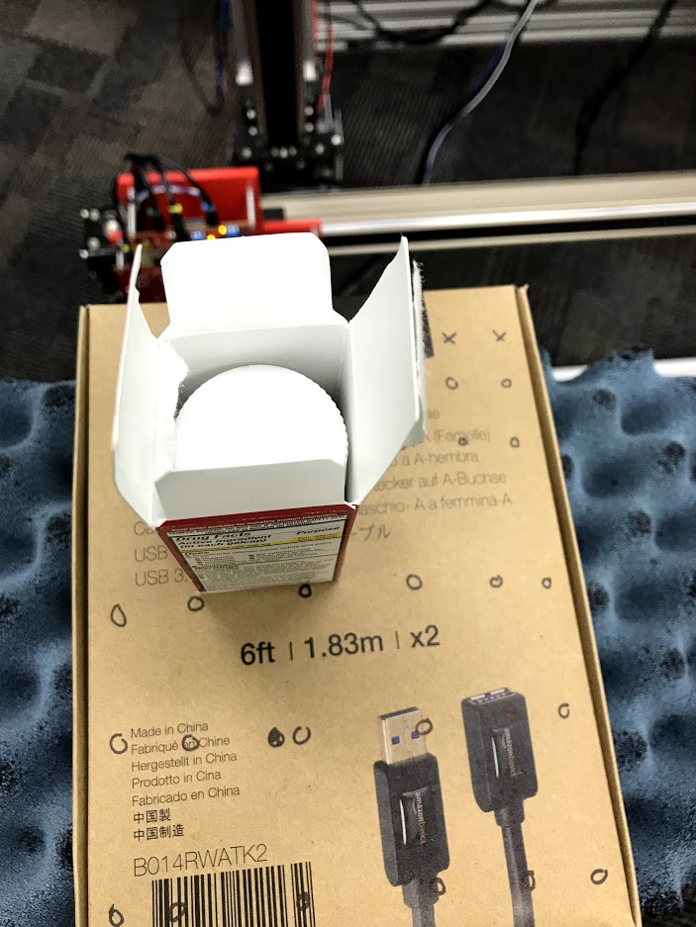
Binary Detection
Box contains either:
Pills in bottle and insert
Pills in bottle and no insert

Slide 23
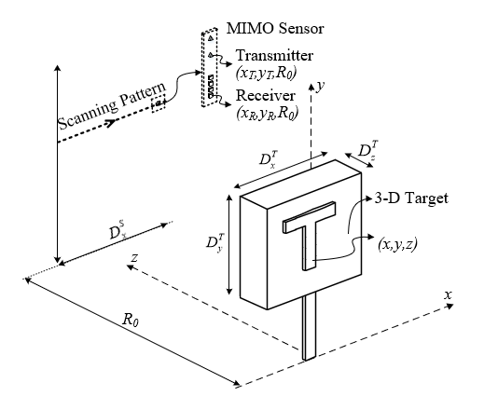

Conveyor Belt Scenario
Box moves along linear path
Orientation could be at any angle
Insert could face towards or away from radar
1000 samples/class
81% classification accuracy

Slide 24
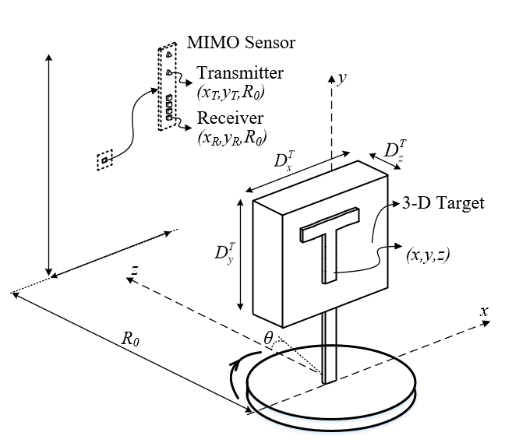
Rotator Scenario
Box is rotated in front of radar
Radar views all sides of the box
Multiple horizontal positions
4000 samples/class
99.9% classification accuracy

Slide 25
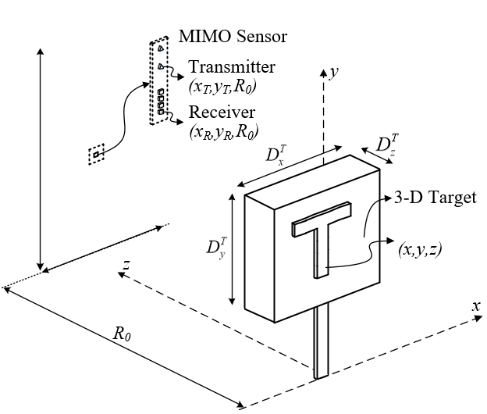
Static Captures
Still images of box are captured
Box at multiple horizontal locations and orientations
More data points
400000 samples/class
82% classification accuracy

Slide 26
Future Work: THz Imaging

Slide 27
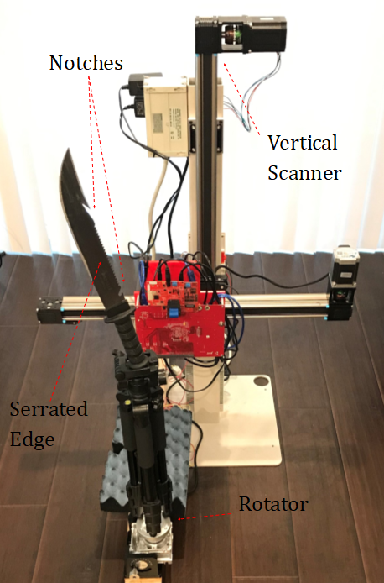
THz Imaging
THz IC – 0.41 THz
Narrowband (~200MHz)
2-D image capable
In progress
TI mmWave Radar – 77GHz
4GHz bandwidth: 2-D and 3-D image capable
Use limited bandwidth to emulate THz chip
Use TI radar to verify narrowband imaging approach

Slide 28
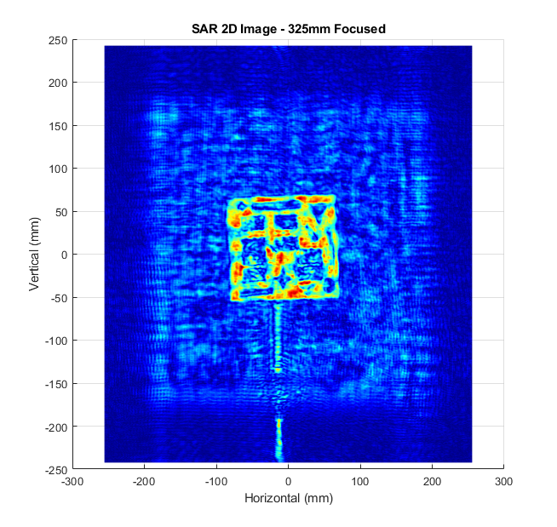
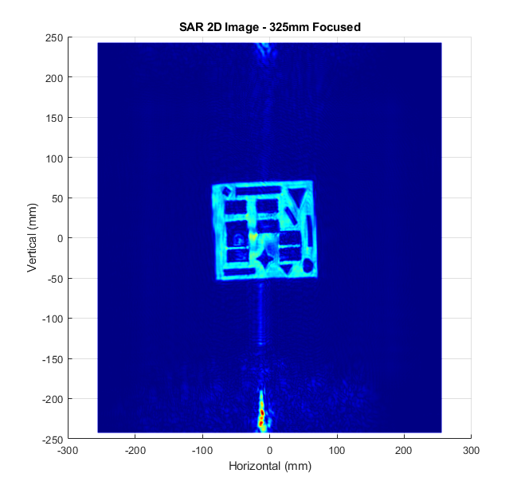
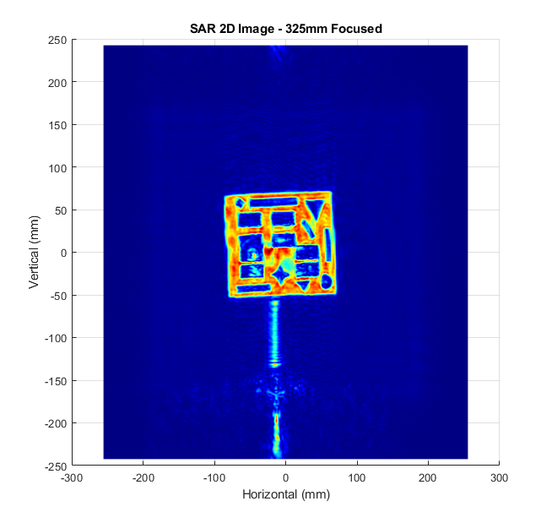
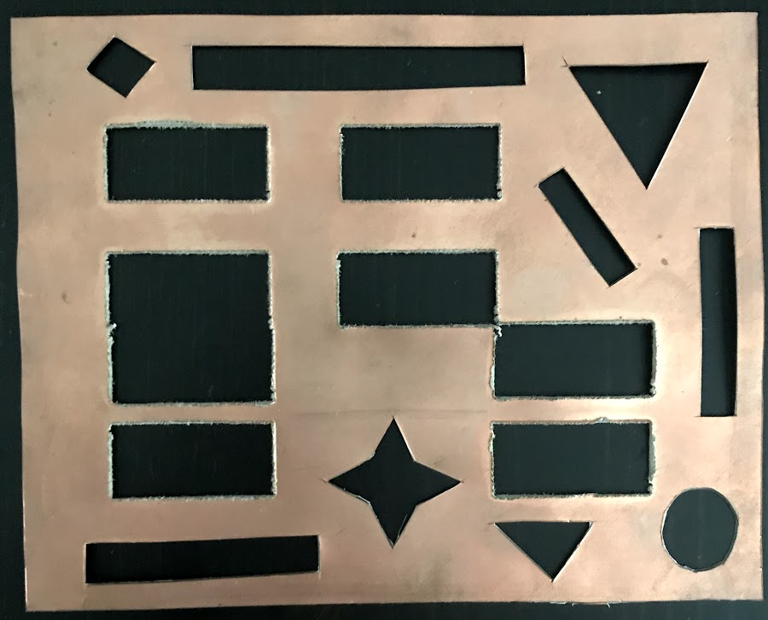
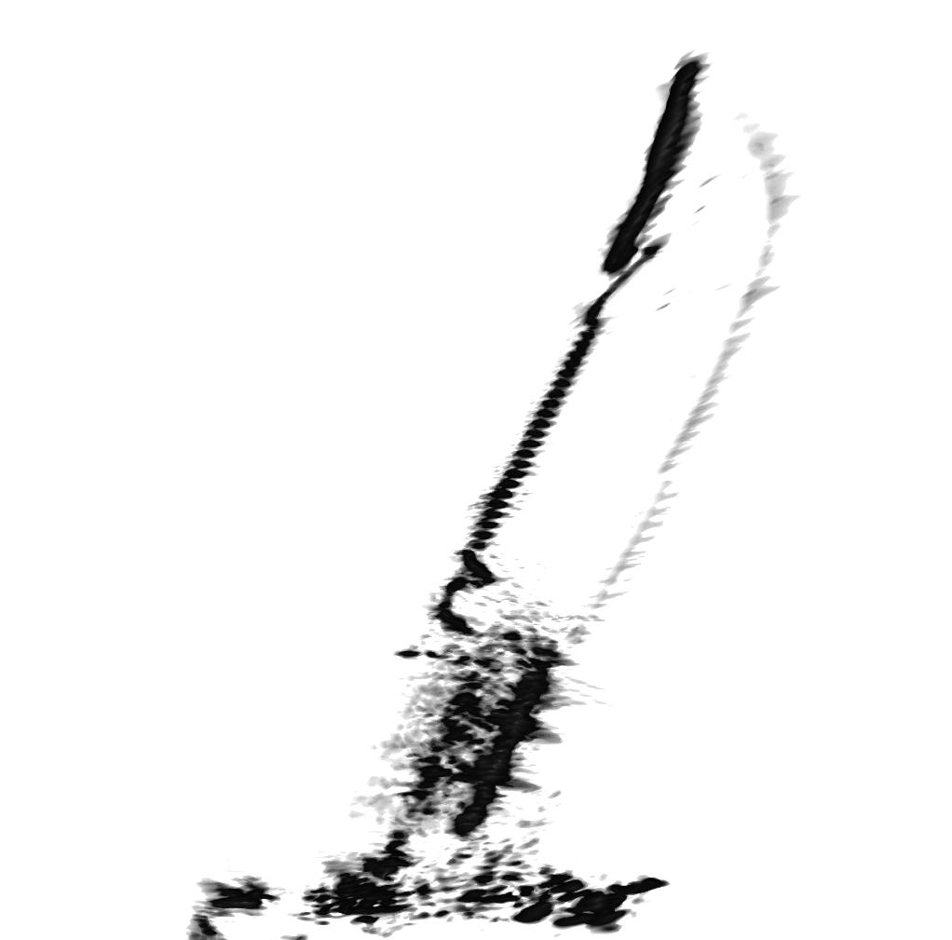
THz Imaging
TI Radar – Narrowband
Single frequency to mimic narrowband THz IC
High resolution 2-D image
TI Radar - UWB
Using 4GHz bandwidth
High resolution 3-D image
Single Frequency
200 MHz
500 MHz

Slide 29
Conclusions and Future Work
Static Pattern Recognition:
Use scanner for fast data acquisition
Train using “sterile” data
Dynamic Pattern Recognition:
Doppler information is key for hand gestures
Ongoing and Future Work:
New applications: automotive & medical arenas
Continued synergy among TxACE groups to obtain THz IC

Slide 30
Machine Learning Algorithms
Richard Willis
Shiva Shankar Thiagarajan
Yiorgos Makris

Slide 31
Overview
Introduction
Objective
Dataset Definition
Data Formats
Architecture and modifications
Results
Analysis for overfitting
Future Work

Slide 32
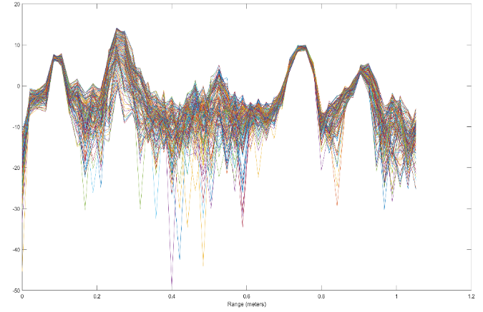
Introduction
Objective – Develop machine learning models for recognizing dynamic gestures
Dynamic Gestures:
Push
Pull
Circle
Wave
Whoosh
Frequency Response
Range (m)

Slide 33
Introduction - Data
No. | Type | Total Captures | Gestures | Captures/Gesture | FFT Size | Frames | Tx/Rx Chs
1 | S | 12000 | 6 | 2000 | 256 | 1 | 4 | Original static
2 | S | 24000 | 6 | 4000 | 512 | 1 | 12 | Large Set
3 | S | 1800 | 6 | 300 | 64 | 1 | 12 | Low variation
4 | D | 2400 | 5 | 600 | 64 | 256 | 12 | Original dynamic
5 | D | 1000 | 2 | 600 | 64 | 512 | 12 | Larger dynamic set
Type: S=Static, D=Dynamic
All datasets utilize 4 receiver channels
Dynamic data set frame captures are ~5ms apart
Currently working on Dynamic Dataset 4.

Slide 34
Introduction – New Data Format
New way of processing dataset 4
600 instances/gesture of [2, 25, 64]
2 * 25 * 64 = 3200 features/sample
Previously, 600 instances/gesture of [2, 12, 64, 256]
2 * 12 * 64 * 256 = 393,216 features/sample
~100x size reduction
Faster loading, processing, training
Reduced overfitting
Total size ~800Mb

Slide 35
Architecture
In:
2 x 25 x 64
Classifier Model
Intermediate Dimensions
1x4x4 Convolution
Stride = 3,4,4
16 channels out
3 x 24 x 61
2x4x4 Convolution
Stride = 3,4,4
16 channels out
9 x 23 x 60
LSTM:
3 Layers
Hidden State Size: 528
1x12,420
Out:1x5
Fully Connected Layer

Slide 36
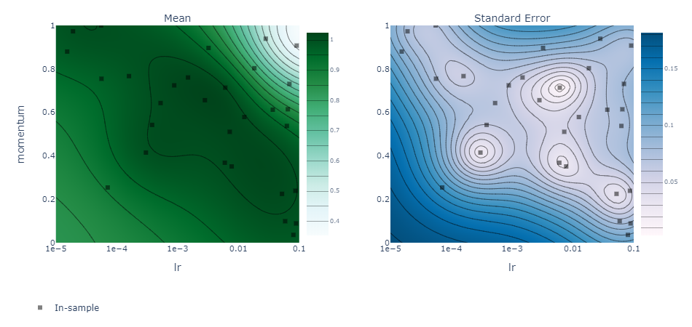
Hyperparameter Tuning
Using Facebook’s Ax platform
Similar graphs generated (not shown) for other hyperparameters
Low accuracy, learning rate/momentum too high
High accuracy, low standard error from cross validation

Slide 37
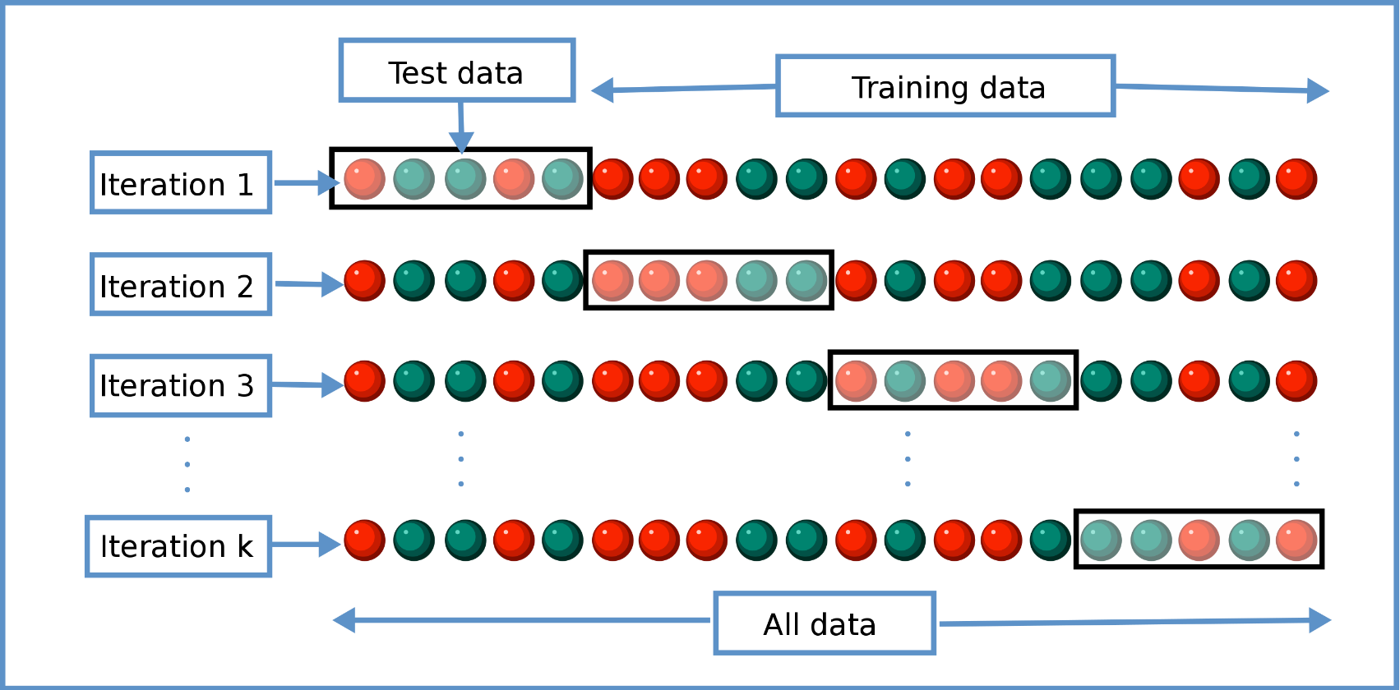
Cross Validation
Repeat training using different parts of dataset for validation each time
Helpful to prevent overfitting to a part of the dataset
https://en.wikipedia.org/wiki/Cross-validation_(statistics)

Slide 38
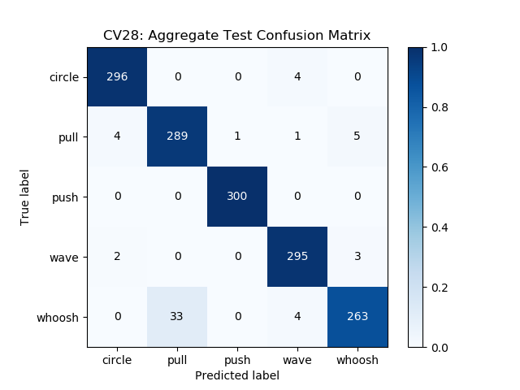
Results
Using Ax to tune hyperparameters, 5 cross-validation runs:
Train Accuracy Avg: 94.8%, Std: 2.1%
Validation Accuracy Avg: 95.2%, Std: 2.6%
Test Accuracy Avg: 93.5%, Std: 2.7%
There was a slight decrease from the ideal accuracies observed with the previous data format
Complexity/accuracy trade-off
Substantially faster, smaller network

Slide 39
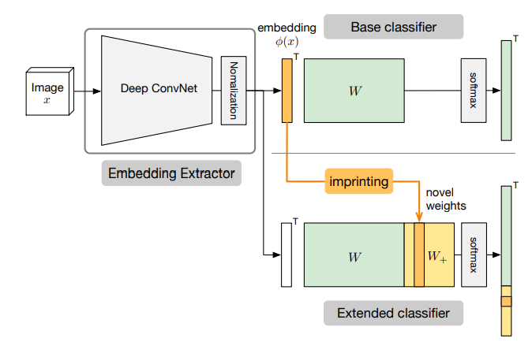
Analysis for Overfitting
Low Shot learning is learning based on a single or small number of training instances
Imprinting is a type of low shot learning
(see right)
Imprinting method can serve as a tool to quantify the overfitting in the network
Worked as expected – not perfect, but relatively high accuracies in most cases with a few low outliers
Allows for making improvements to the model and validating its robustness.
Ref: Low-shot Learning with Imprinted Weights (https://arxiv.org/abs/1712.07136)
Thanks to Arthur Redfern (Liaison) for his feedback

Slide 40
Imprinting Results
Generally high accuracies across the board
Confusion matrix for whoosh (worst extended test accuracy) on following slide
 | Base Train | Base Test | Extended Train | Extended Test
Push | 98.1% | 99.2% | 91.5% | 80.8%
Pull | 98.9% | 99.0% | 93.8% | 86.0%
Wave | 97.3% | 96.5% | 93.1% | 95.3%
Circle | 94.7% | 94.4% | 79.4% | 88.7%
Whoosh | 96.6% | 96.9% | 72.6% | 78.4%

Slide 41
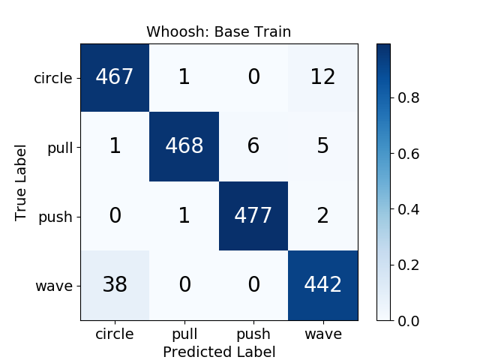
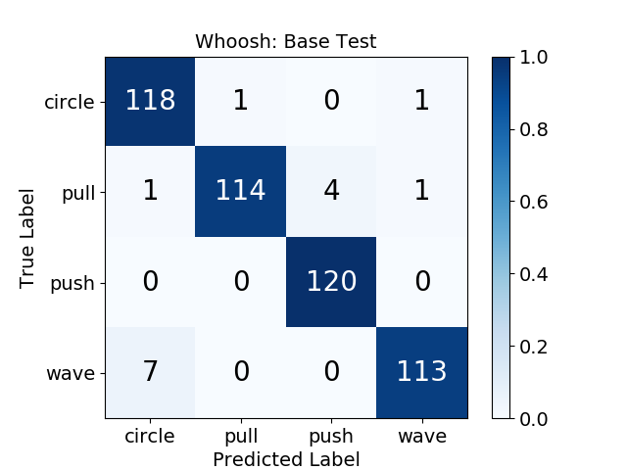
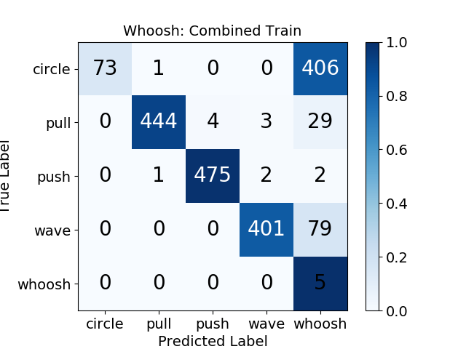
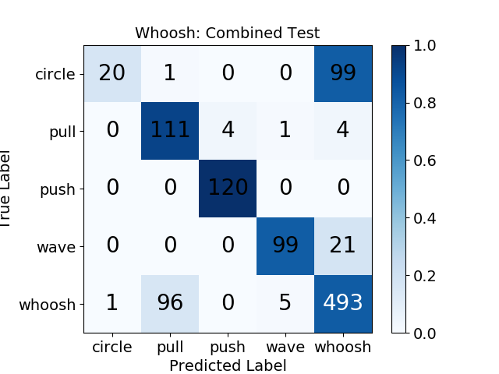
Imprinting Results – Whoosh
Train
Test
Base
Extended

Slide 42
Future Work
Model Improvements:
Defining a scalar metric based on imprinting results for quantifying model overfitting
Refine architecture and hyperparameter selection based on overfitting metric
Dataset Improvements:
Improving data by introducing variability in the collection process, such as new orientation, multiple people
Dataset pre-processing must be able to handle data cropping and adapt to adjustments within the frames.
Real-time Platform Implementation:
Identify the hardware and software requirements for implementing an on-the-fly platform for recognizing gestures.

Slide 43
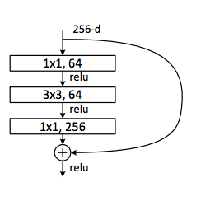
Future Work
Model Improvements:
Implementing deeper networks with ResNet bottlenecks
Improves feature extraction
Reducing features in final classification vector
Decreases overfitting, computational complexity, Currently ~10⁵, target 10² – 10³
Train with weight penalty (L2 regularization)
Reduces overfitting
Prevents weights from focusing in on one feature for classification / generates a more general solution
Train with Adam (optimization algorithm)
Uses individual learning rate for each parameter.
Thereby training faster than stochastic gradient method.

Slide 44
Plans and Deliverables (Year 2/3)
Milestones
Developed a MATLAB based GUI to streamline raw mmWave radar and IR sensor data collection
Performed the initial testing of machine learning methods with real mmWave data sets
Two PhD students (Josiah/Bhaskar) working on various application such as gesture recognition/imaging with 77GHz TI radar until THz radar becomes available
Students (Richard/Shiva) working on advances machine learning algorithms for dynamic gestures (static gestures before), implemented a flexible python-based infrastructure for gesture recognition using radar information.
Trained models were investigated for various shortcomings and refined to improve the model robustness.
Deliverables
Software on the HGR DSP and ML methods (Nov. 15, 2020)
THz imaging testbed (Nov. 15, 2020)

Slide 45
Plans and Deliverables (Years 3/4)
Plans
Extend machine learning/Deep learning methods with new THz sensor
Software implementation of machine learning algorithms for THz sensing/imaging
Improve gesture recognition for classifying dynamic gestures (3rd year)
Present narrowband imaging examples with THz sensor (3rd year)
Improve the robustness of dynamic gesture classification with confidence metrics (3rd year)
Deliverables
Report on the results of new applications using mmW demonstrator and multi antenna signal processing and machine learning for hand gesture recognition.
Software implementation of multi antenna signal processing and machine learning for dynamic hand gesture recognition.

Slide 46
Advanced Algorithms for Sensing and Recognition: Current Schedule
Year | 1 | 2 | 3 | 4 | 5
Milestones | Develop a detailed mathematical model for THz FPA with reflectors and THz transceivers. Develop a geometric reference model including Doppler shift patterns for 3D gesture recognition and motion detection Software implementation of machine learning algorithms for THz sensing/imaging. | Complete 24/77 GHz hardware demonstrator with existing chipsets to achieve millimeter-scale accuracy in 3D gesture recognition and motion recognition. Develop multi antenna signal processing to reduce speckles and to correct reflector aberration and machine learning techniques. | Software implementation of real-time multi antenna signal processing techniques and machine learning algorithms for THz-FPA on a custom CPU+GPU. Refine the mathematical models of THz-FPA and geometric models based on 77 GHz demonstrator results. | Verify and fine tune low complexity algorithms with THz FPA on silicon with TI and center collaborators. Software implementation of machine learning algorithms on a custom CPU+GPU for THz sensors. Finalize the algorithms to eliminate errors due to multipath. | (If all the milestones are met and authorized by TI) Build and characterize optimized resolution limits of THz FPA with THz chipsets incorporating reflectors and machine learning on CPU/GPU/FPGA for 3D gesture and motion recognition. Characterize the performance limits of aberration mitigation algorithms.
Deliverables | Report on the mathematical model of THz FPA with reflectors and THz radios Report on geometric models for 3D gesture recognition and the machine learning algorithms for THz sensing/imaging | Report on measurement results using 24/77 GHz demonstrator. Software implementation of multi antenna signal processing and machine learning for THz-FPA gesture and motion detection | Report on software implementation and refined mathematical models of the end-to-end sensing and imaging system with machine learning algorithms. Report on the algorithms to increase field of view. | Report on measurement results on the performance limits of multiantenna signal processing algorithms and machine learning techniques used in THz-FPA sensors. | Report on measurement results of fully functional THz-FPA imager enabled by real-time multiantenna signal processing algorithms and machine learning. CPU/GPU/FPGA software.

Slide 47

Questions ??

Slide 48
References
[1] H. Kaur and J. Rani, "A review: Study of various techniques of Hand gesture recognition," 2016 IEEE Int. Conf. on Power Electronics, Intelligent Control and Energy Systems, Delhi, 2016, pp. 1-5.
[2] M. K. Ahuja and A. Singh, "Static Vision Based Hand Gesture Recognition Using Principal Component Analysis, " pp. 402-406, 2015.
[3] D. Q. J. Dqg, V. lurp, L. Pdun, O. Kdqg, H. W. Lv, K. Kinect, H. G. Recognition, Z. Fdq, E. H. Fodvvlilhg, E. S. Fodvvlilhuv, and V. Dv, "using Kinect Depth Camera, " pp. 5-8,2015.
[4] J. S. Sonkusare, N. B. Chopade, R. Sor, and S. L. Tade, "A Review on Hand Gesture Recognition System, " 2015 Int. Conf Comput. Commun. Control Autorn., pp. 790-794, 2015.
[5] L. Chen, F. Wang, H. Deng, and K. Ji, "A survey on hand gesture recognition, " 2013 Int. Conf. Comput. Sci. Appl. CSA 2013, pp. 313-316,2013.
[6] S. Atsushi, "Hand Gesture based TV Control System, " Korea -Japan Jt. Work. Front. Comput. Vis., pp. 121-126,2013.
[7] S. Muttena, R. Shiva, S. Sriram, and S. Murugavalli, "Simulation of Speech by Identifying and Classifying Dynamic Gestures, " no. May, pp. 192-197,2015.
[8] J. Chastine, N. Kosoris, and J. Skelton, "A study of gesture-based first person control, " Proc. CGAMES - Int. Conf Comput. Games AI, Animat. Mobile, Interact. Multimedia, Educ. Serious Games, pp. 79-86,2013.
[9] S. S. Rautaray and A. Agrawal, "Vision based hand gesture recognition for human computer interaction: a survey, " Artif. IntelI. Rev., vol. 43, no. 1,2012.
[10] Z. Ren, J. Meng, and J. Yuan, "Depth Camera Based Hand Gesture Recognition and its Applications in Human-Computer-Interaction, " Proc. IEEE Int. Conf Inf Commun. Signal Process., no. I, pp. 3-7, 2011.
[11] J. L. Raheja, M. Minhas, D. Prashanth, T. Shah, and A. Chaudhary, "Robust gesture recognition using Kinect: A comparison between DTW and HMM, " Optik (Stuttg)., vol. 126, no. 11-12, pp. 1098- 1104,2015.
12] L. Xuan and Z. Hong, "An improved canny edge detection algorithm," 2017 8th IEEE International Conference on Software Engineering and Service Science (ICSESS), Beijing, 2017, pp. 275-278.
[13] Z. Zhang, Z. Tian and M. Zhou, "Latern: Dynamic Continuous Hand Gesture Recognition Using FMCW Radar Sensor," in IEEE Sensors Journal, vol. 18, no. 8, pp. 3278-3289, April15, 15 2018.
[14] M. E. Yanik and M. Torlak, “Near-Field MIMO-SAR Millimeter-Wave Imaging With Sparsely Sampled Aperture Data,” IEEE Access, vol. 7, pp. 31801–31819, 2019.

Slide 49
Backup Slides

Slide 50
Future Work: Automotive Scene Classification

Slide 51
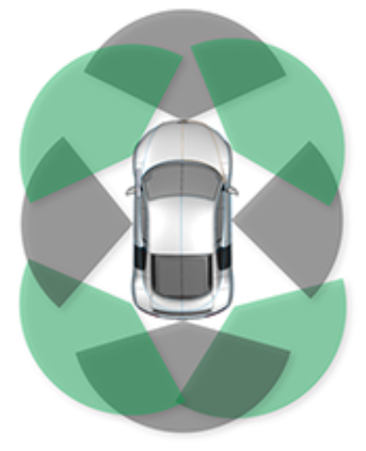
Automotive Scene Classification
Radar continuously capturing images from a moving vehicle
Estimate the range of targets in various environments
Target classification: human, stationary object, another vehicle (stationary or moving)
Initial Steps:
Capture dynamic motions with scanner
Classify human movements
Image Courtesy of TI

Slide 52
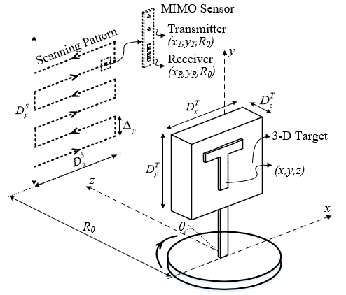
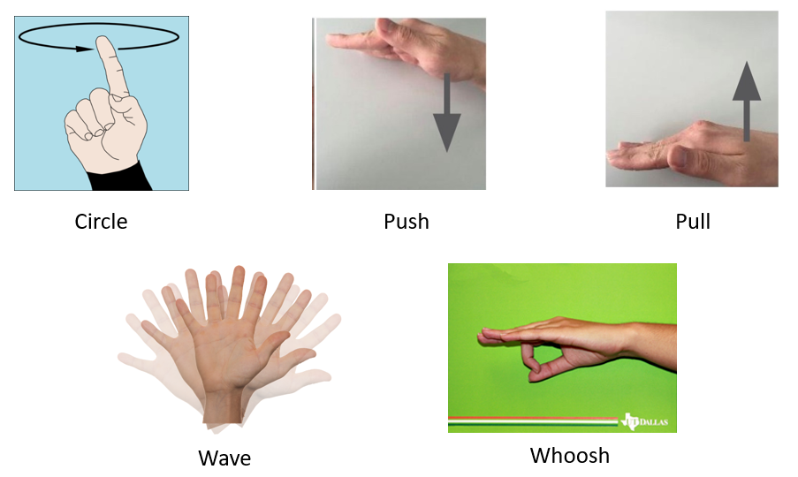
Relevant Past Work
3D MIMO-SAR Imaging Algorithms
Scene generation for segmentation and classification
Leverage MIMO virtual array elements for larger virtual aperture
Dynamic Gesture Recognition
Doppler information extraction

Slide 53
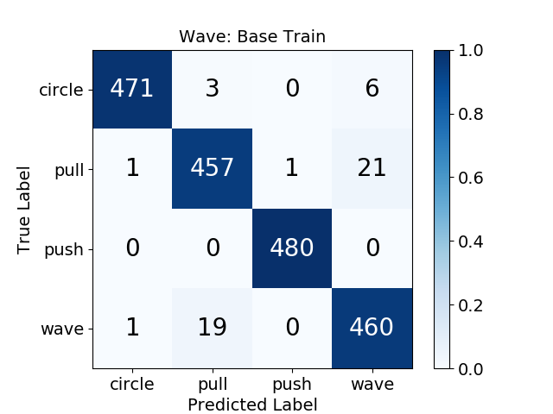

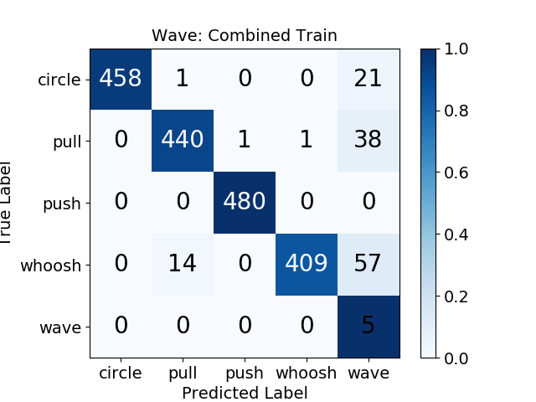
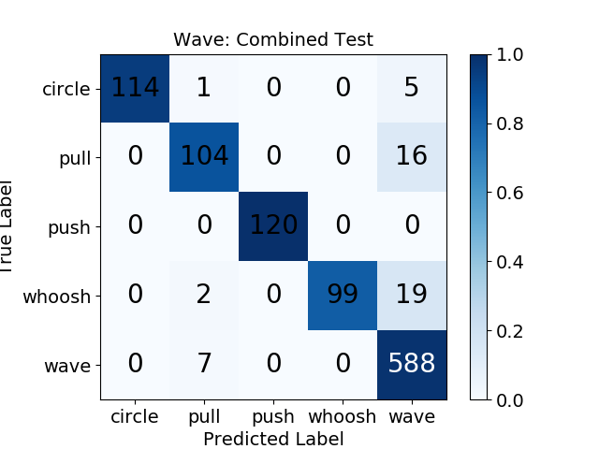
Imprinting Results – Wave
Train
Test
Base
Extended

